Slide 1
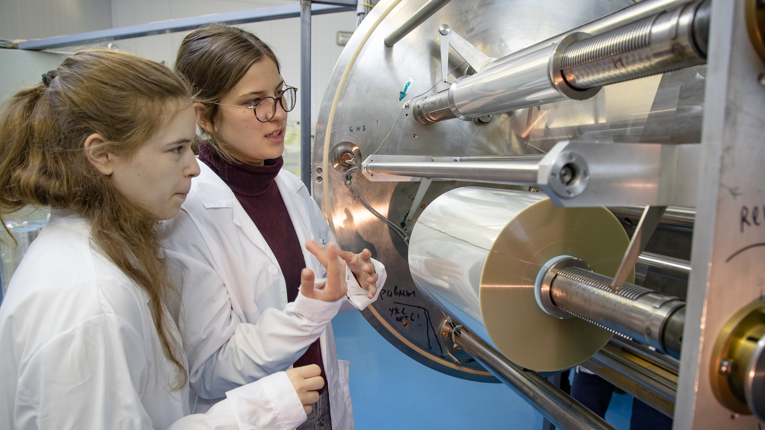
VIRTUAL LAB 2020
WAYS OF COLLABORATION
Klygina Kseniia
Online meeting for
JINR information centers
December 2020, Dubna

Slide 2
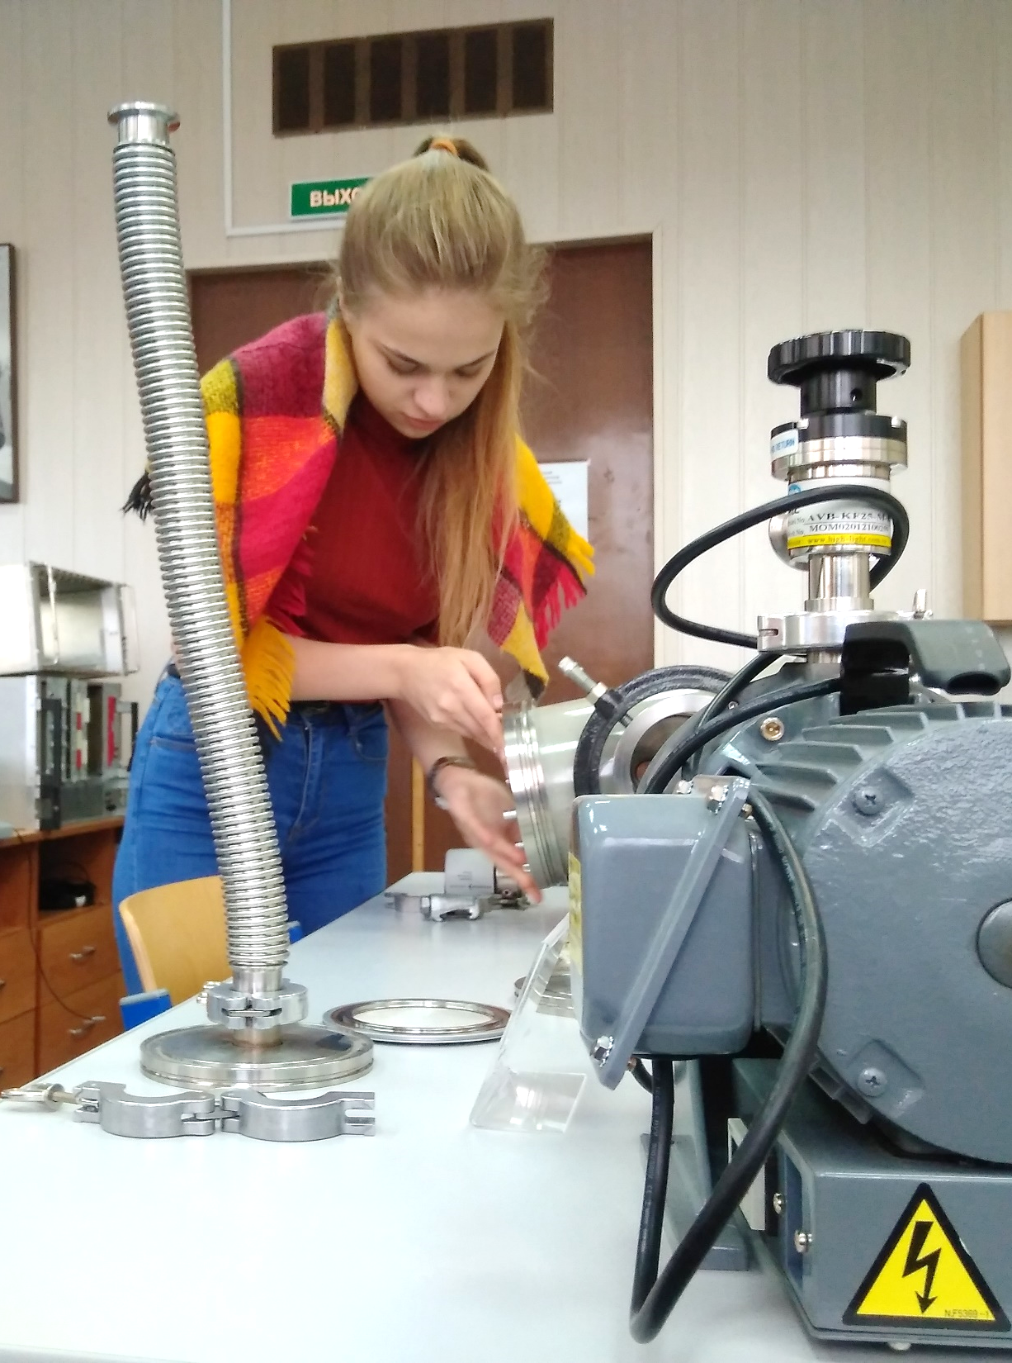
01
About the Project
Contents
02
Introductory Course
03
Virtual Practicums
04
Hands-On Practicums
05
Platform for Remote Labs
06
Workshops 2020
07
Directions of Collaboration

Slide 3
About the Project

Slide 4
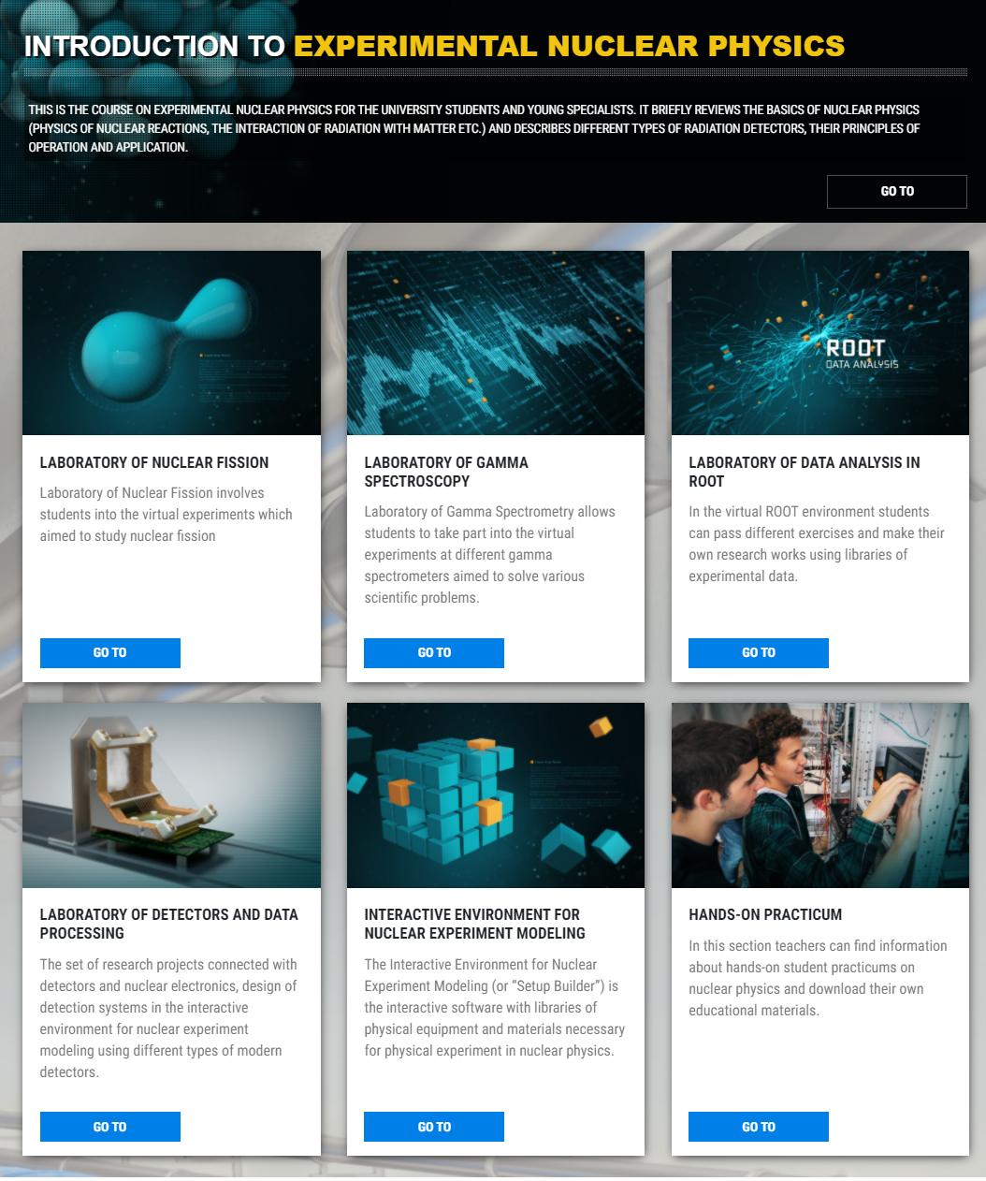
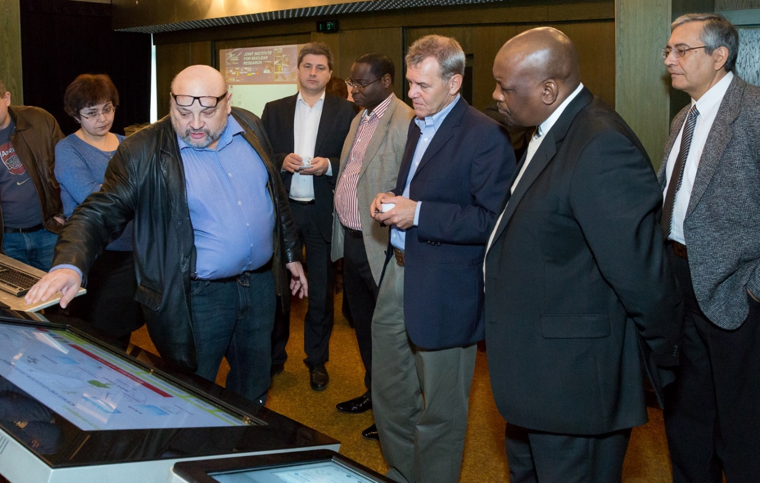
The goal of the project is to include current scientific data into the educational process, to conduct virtual and online laboratory research based on using modern scientific equipment and data obtained from the existing physical facilities.

Slide 5
PROJECT GEOGRAPHY
Joint Institute for Nuclear Research
Dubna State University
National Research Nuclear University MEPhI
National Research Nuclear University MEPhI
North Ossetian
State University
Warsaw University of Technology
North Ossetian
State University
Warsaw University of Technology
University of Novi Sad
University of Novi Sad
Mongolian State University of Education
Mongolian State University of Education
Institute for Nuclear Researches and Nuclear Energy
Institute for Nuclear Researches and Nuclear Energy
St. Kliment Ohridski the University of Sofia
St. Kliment Ohridski the University of Sofia
Stellenbosch University
Stellenbosch University
Department of Science and Technology (SA)
Department of Science and Technology (SA)
University of South Africa (UNISA)
iThemba LABS

Slide 6
Introductory Course

Slide 7
INTRODUCTION TO EXPERIMENTAL NUCLEAR PHYSICS
Author:
Prof. Ivan Vankov

Slide 8
Virtual Practicums

Slide 9
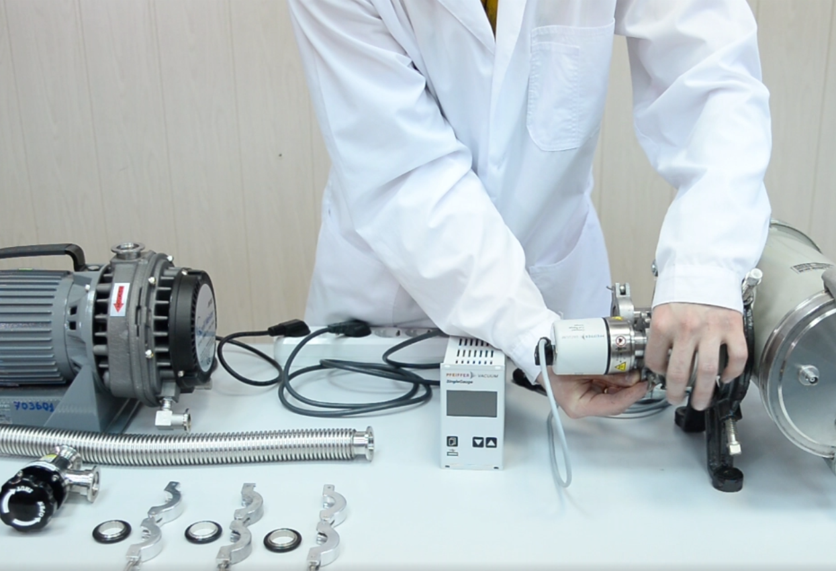
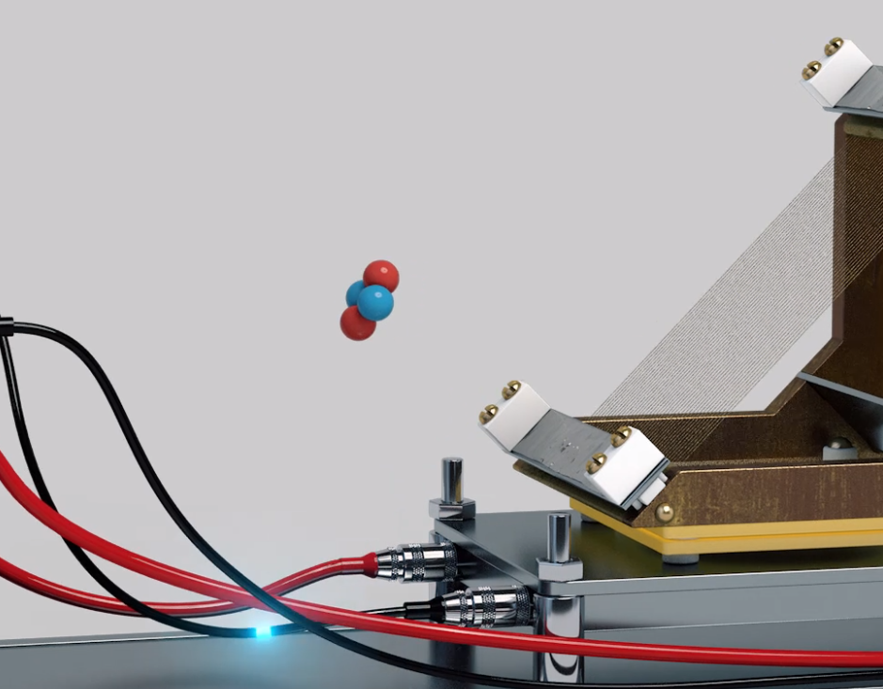
VIRTUAL PRACTICUMS

Slide 10
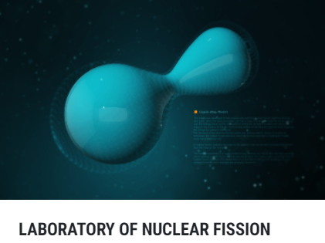
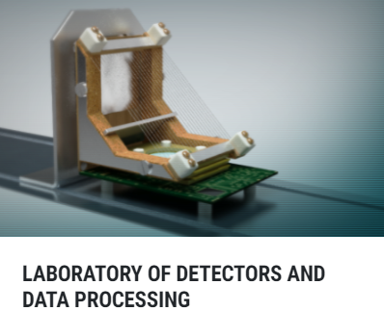
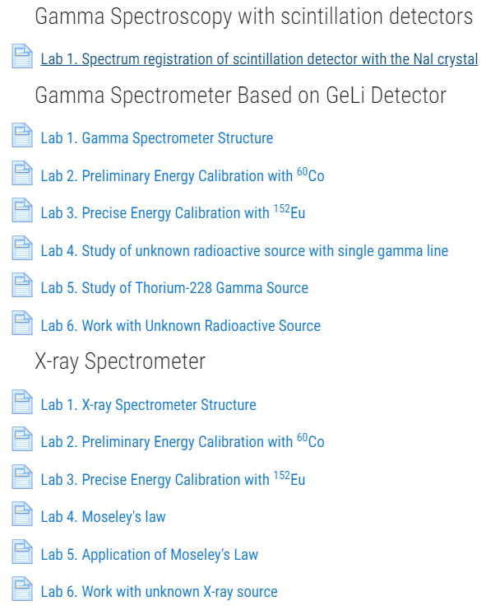
VIRTUAL PRACTICUMS

Slide 11
Hands-On Practicums

Slide 12
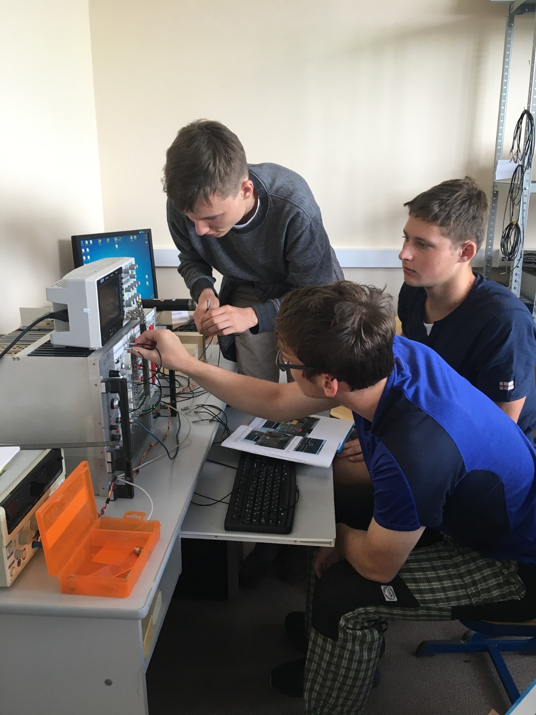
Hands-On Practicums
Basics of electrical pulse measurements
Scintillation telescope for studies of cosmic rays
Scintillation hodoscope based on silicon photomultipliers
Gamma spectrometry
X-ray spectrometry. Moseley’s law
Work with modern detectors and nuclear electronics
Work with Vacuum Systems

Slide 13
FUTURE: Platform
for Remote Labs

Slide 14
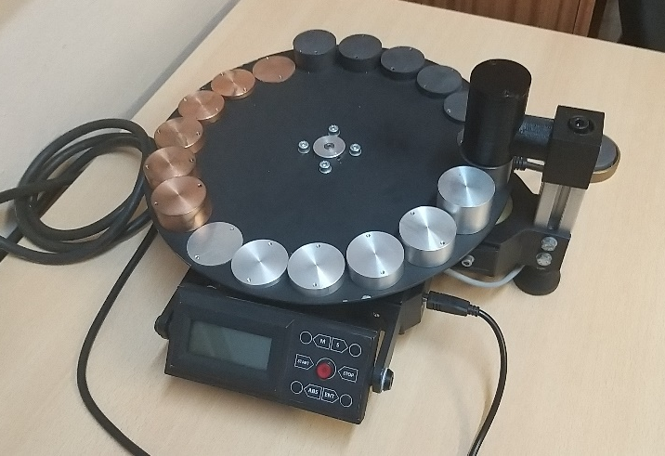
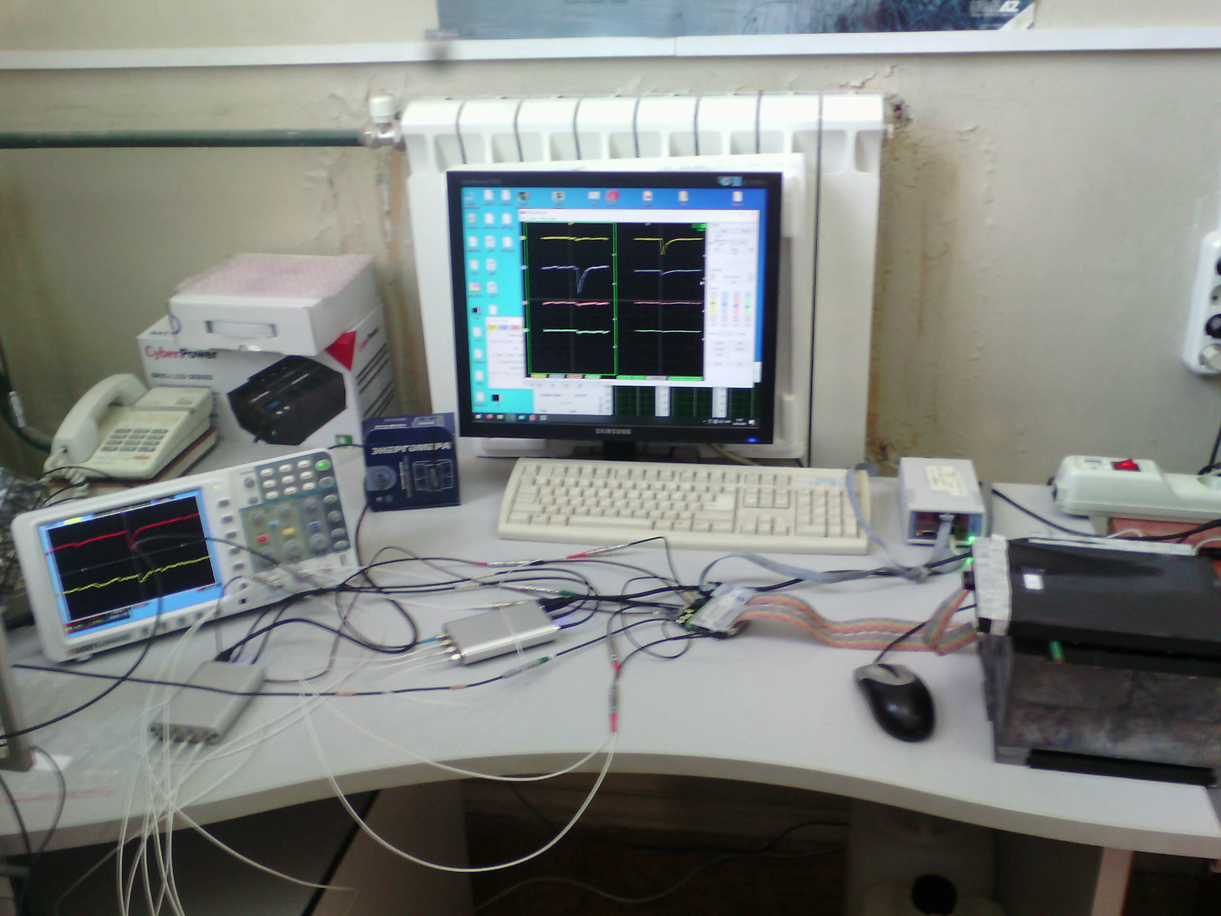
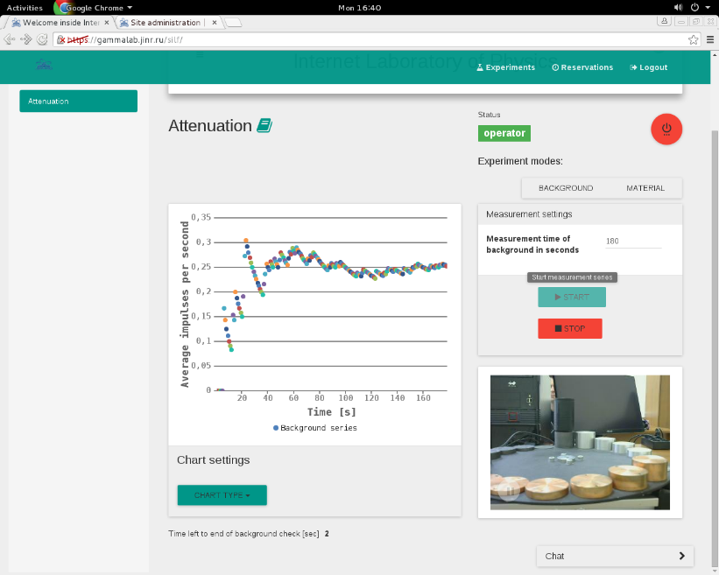
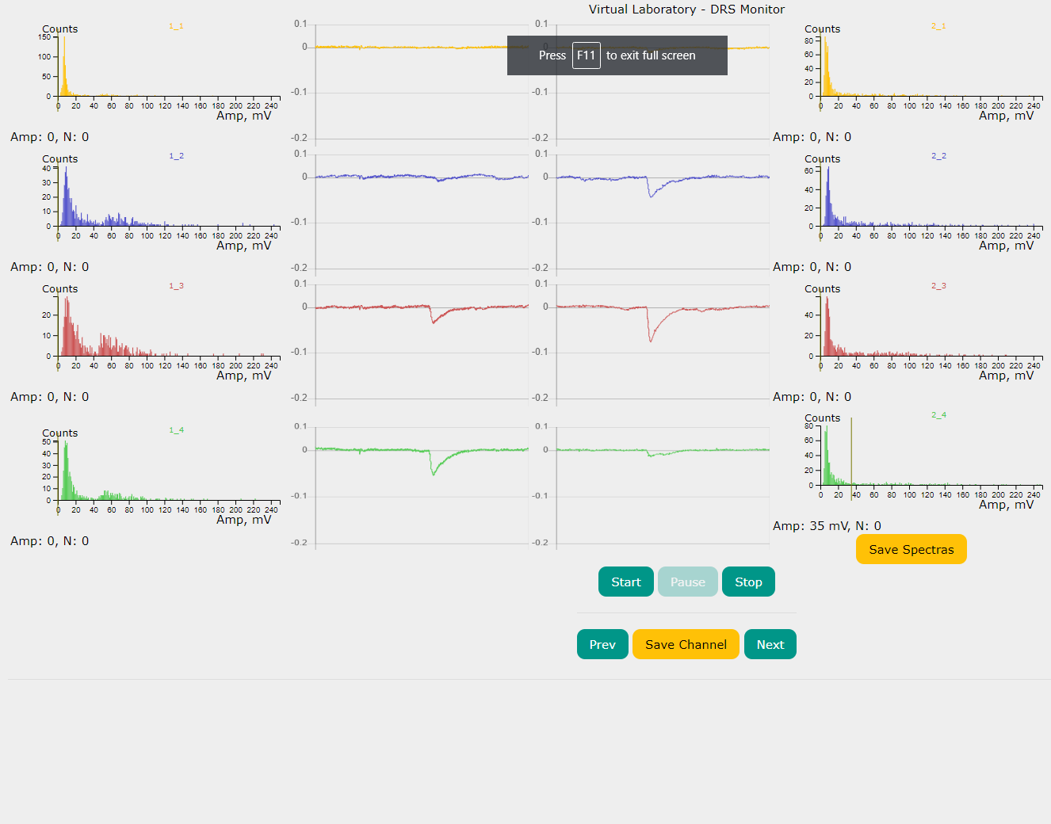
PLATFORM FOR REMOTE LABS
Distributed platform for the integration and use of remote experiments from various developers:
provides remote use of experimental equipment and real data collection
includes protocol for interaction of experimental equipment with the platform

Slide 15
Workshops 2020

Slide 16
WORKSHOP ACTIVITIES
POPULAR LECTURES
LECTURE ‘Introduction into Experimental Nuclear Physics’
History of Nuclear Physics
Colliders
VIRTUAL PRACTICUM
Introductory lecture
Practicum in a computer class
ROOT PRACTICUM
Introductory lecture
Practicum in a computer class
VR EXCURSIONS TO JINR FACILITIES

Slide 17
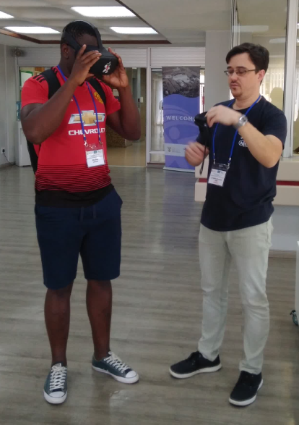
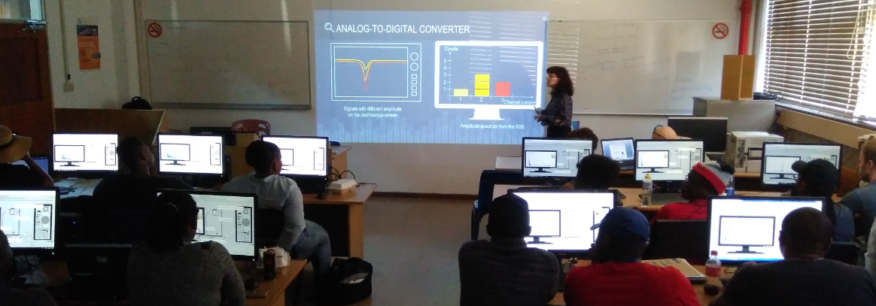
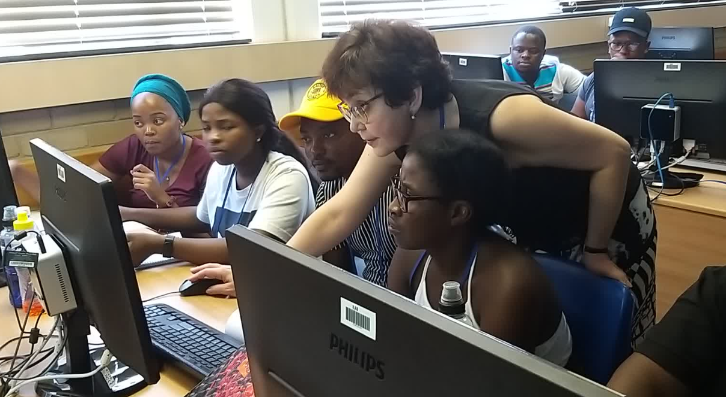
WORKSHOP ACTIVITIES
LECTURES
LECTURES
ROOT PRACTICUM
VR EXCURSIONS
VIRTUAL PRACTICUM
VIRTUAL PRACTICUM
ROOT PRACTICUM

Slide 18
Directions of Collaboration

Slide 19
DIRECTIONS OF COLLABORATION
Using the project materials in the university curriculum
Joint development of virtual and remote practicums
Hands-on practices for university and high school students in Dubna
Workshops on experimental nuclear physics for university and high school students
Translation of the project educational materials into the native language

Slide 20
Thank You

