Slide 1
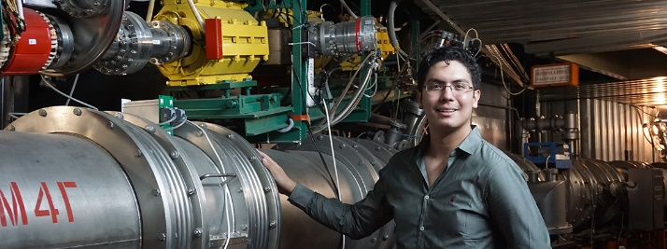

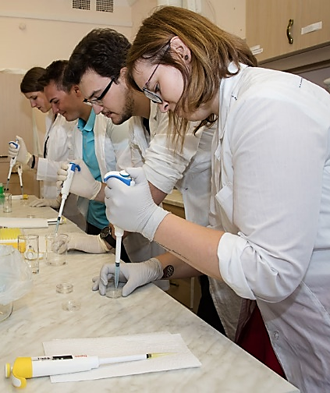
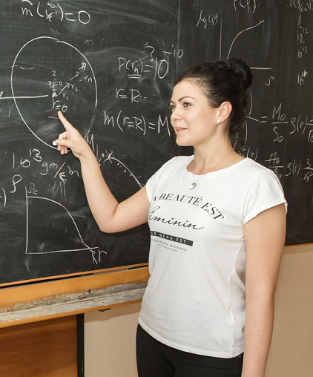
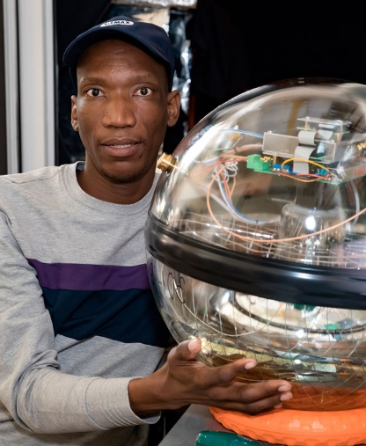
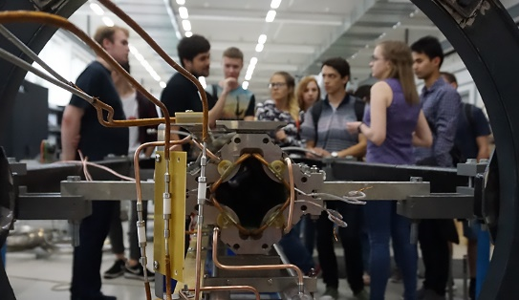
JINR information centre
University
Centre
World-class
research projects
and opportunities
for students
Unique
opportunities
for training
Variety
of student programmes
Prof. Stanislav Pakuliak
JINR UC Director
E-mail: pakuliak@jinr.ru
Websites: uc.jinr.ru
Wide range
of research fields

Slide 2

JINR Information Centre
Functions:
Raise and maintain the interest to JINR research
Organise events (i.e. Science Olympiads, etc.) in your country
Select talented young people interested in science and assist their participation in JINR activities
University
students
School teachers
LOCAL
INFOCENTRE
School
students
JINR

Slide 3
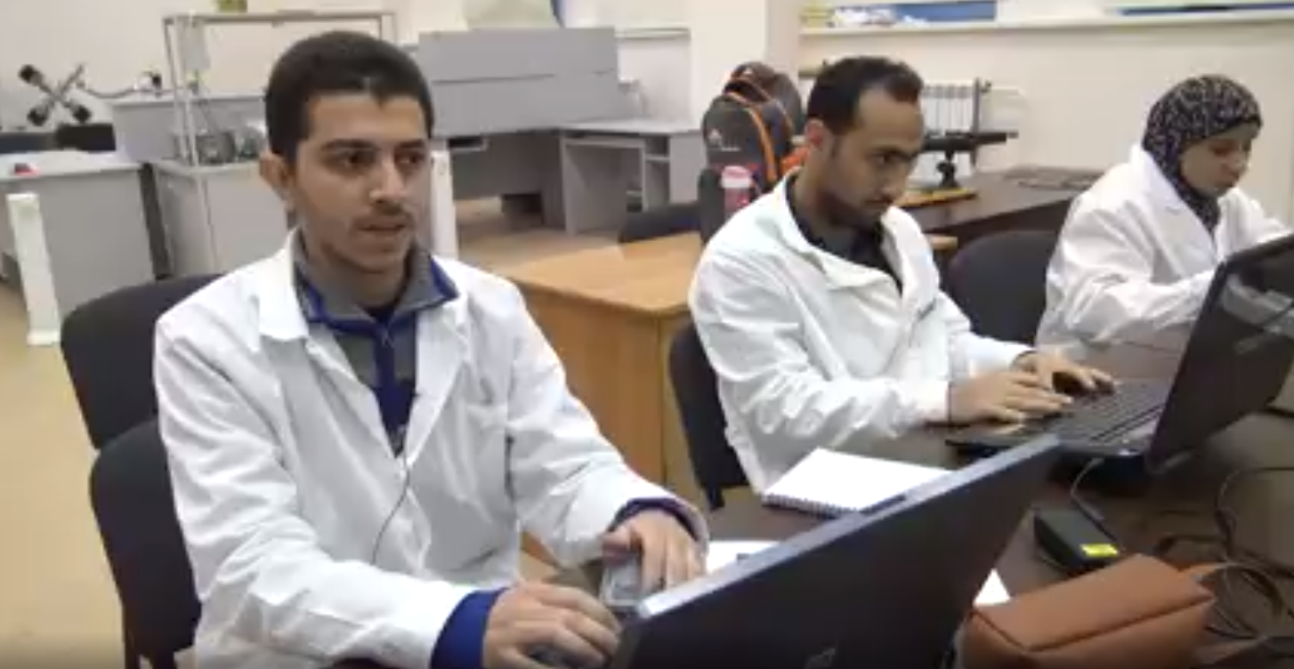
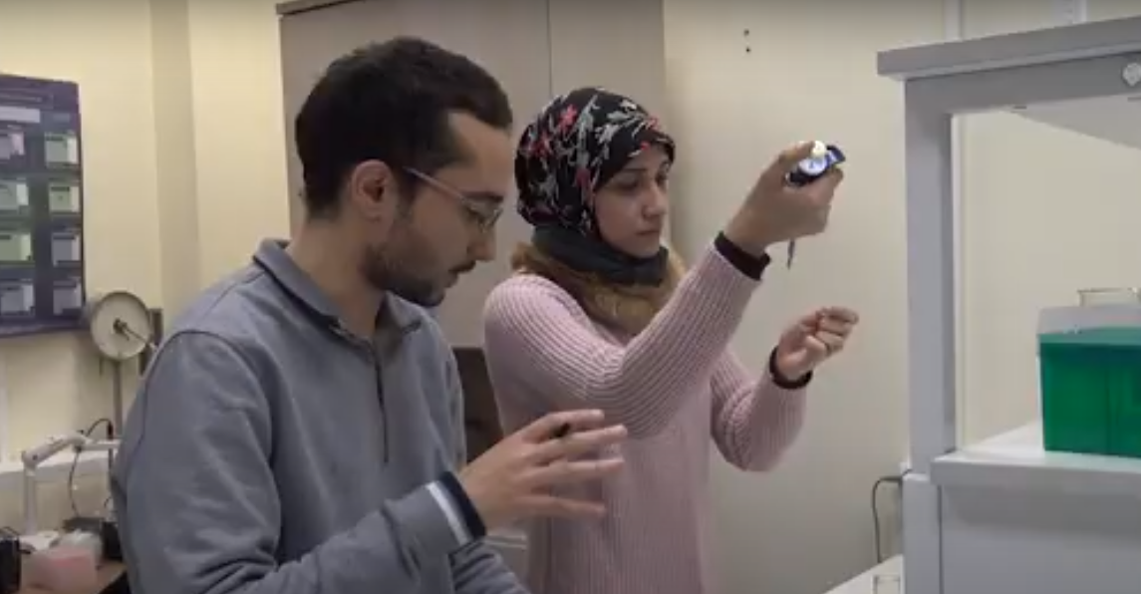
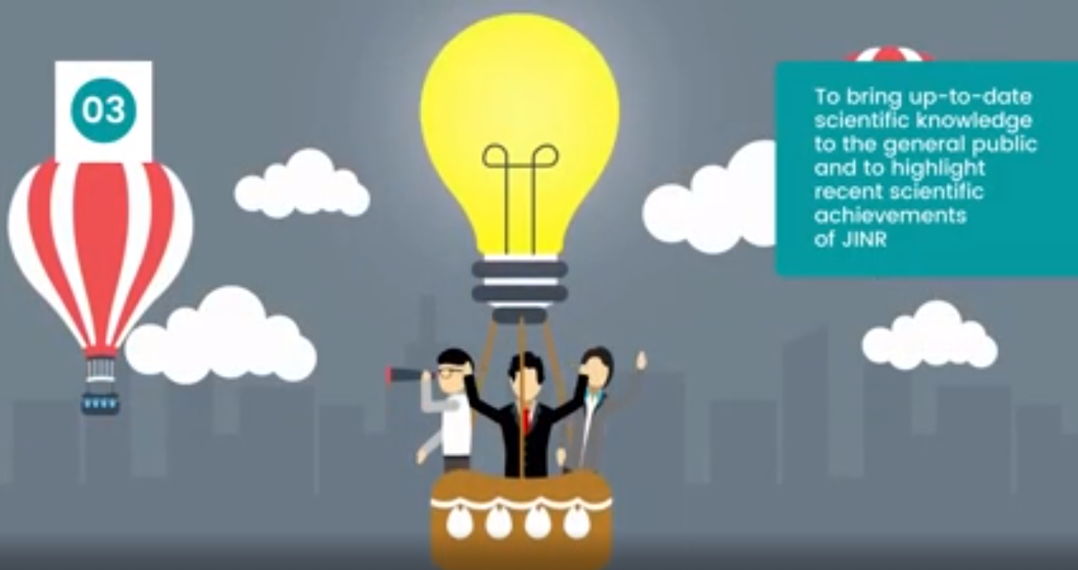
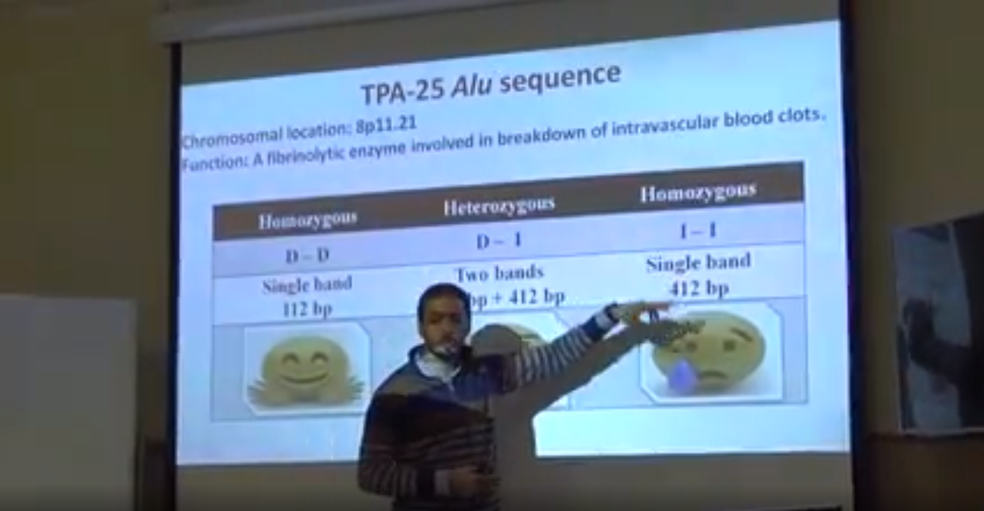
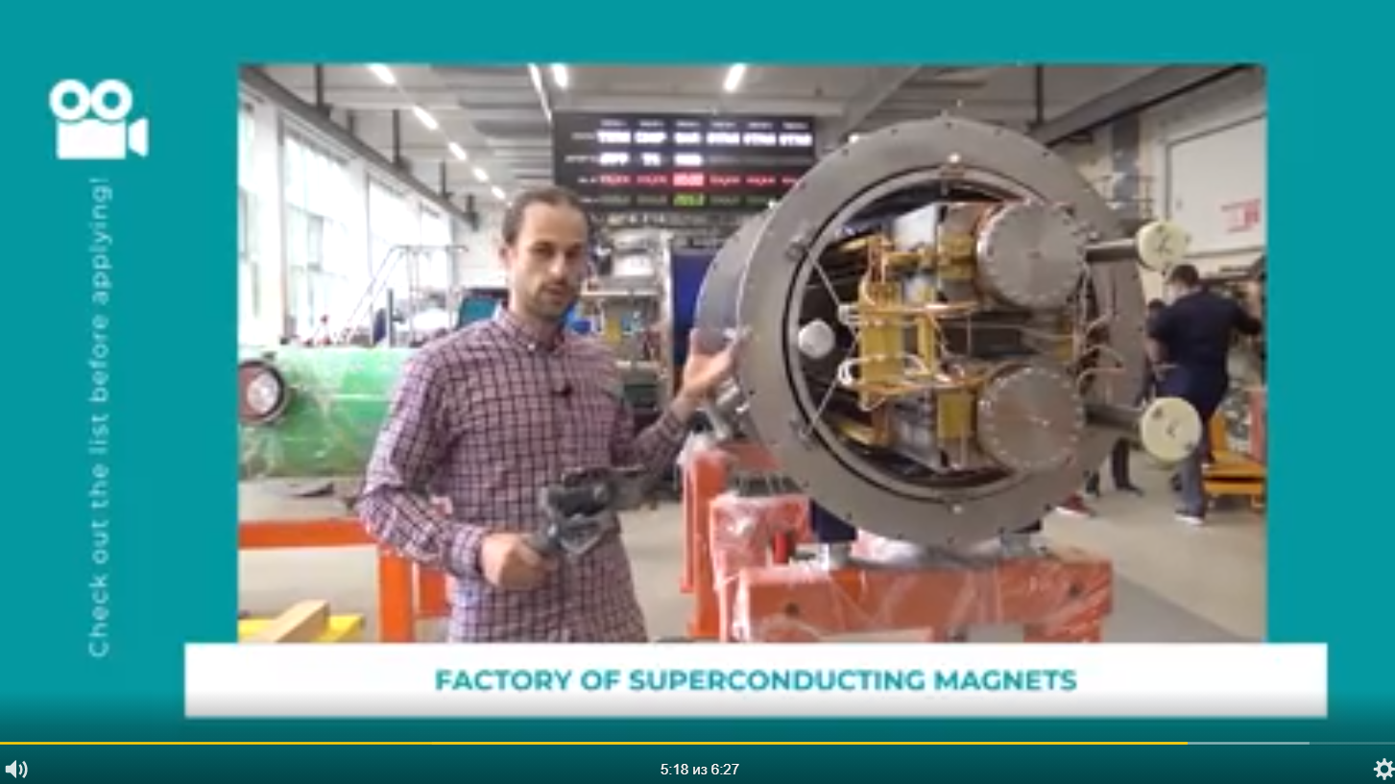
Watch the video
Practice of students from Egypt & Online tours to the JINR Labs
https://www.youtube.com/watch?v=OLyeXwsmurU&feature=youtu.be

Slide 4
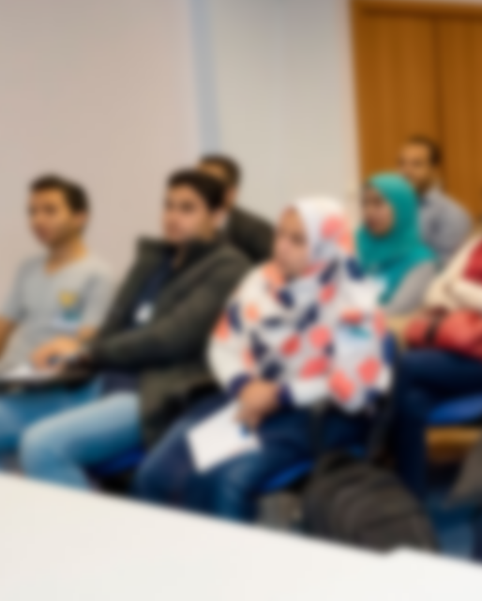

What is JINR University Centre?
Student programmes
BSc and MSc theses at JINR
INTEREST – online student training NEW
International Student Practices
Summer Student Programme
Conferences for young scientists and specialists
Outreach activities
Scientific Schools for Physics Teachers at JINR and CERN
Visits to the JINR labs for students
E-learning resource edu.jinr.ru
Science festivals
Skill improvement
Attachment of degree-seekers
Trainings for engineers
Trainings for technical personnel
Foreign language courses for employees
Attracting youth to science

Slide 5
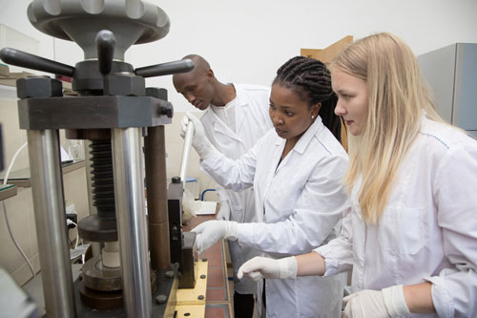
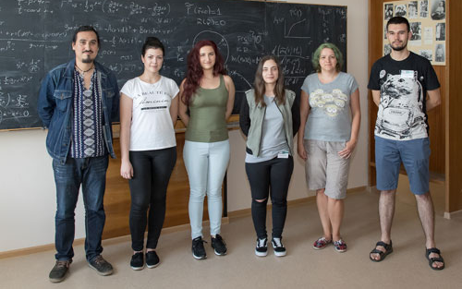
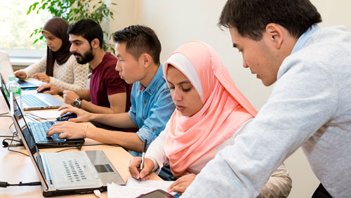
International Student Practices
uc.jinr.ru/en/isp
Highlights:
3 weeks
launched in 2004
over 2000 participants
Your chance to:
get an idea about the JINR
fields of research
work at the basic facilities
of the Institute under supervision
of the leading experts
choose a future scientific supervisor
make useful contacts
enjoy the Russian culture
June
South Africa
July
Azerbaijan, Bulgaria,
Czech Republic,
Poland, Romania,
and Slovakia
September
Belarus, Cuba, Egypt,
Mongolia, and Serbia

Slide 6
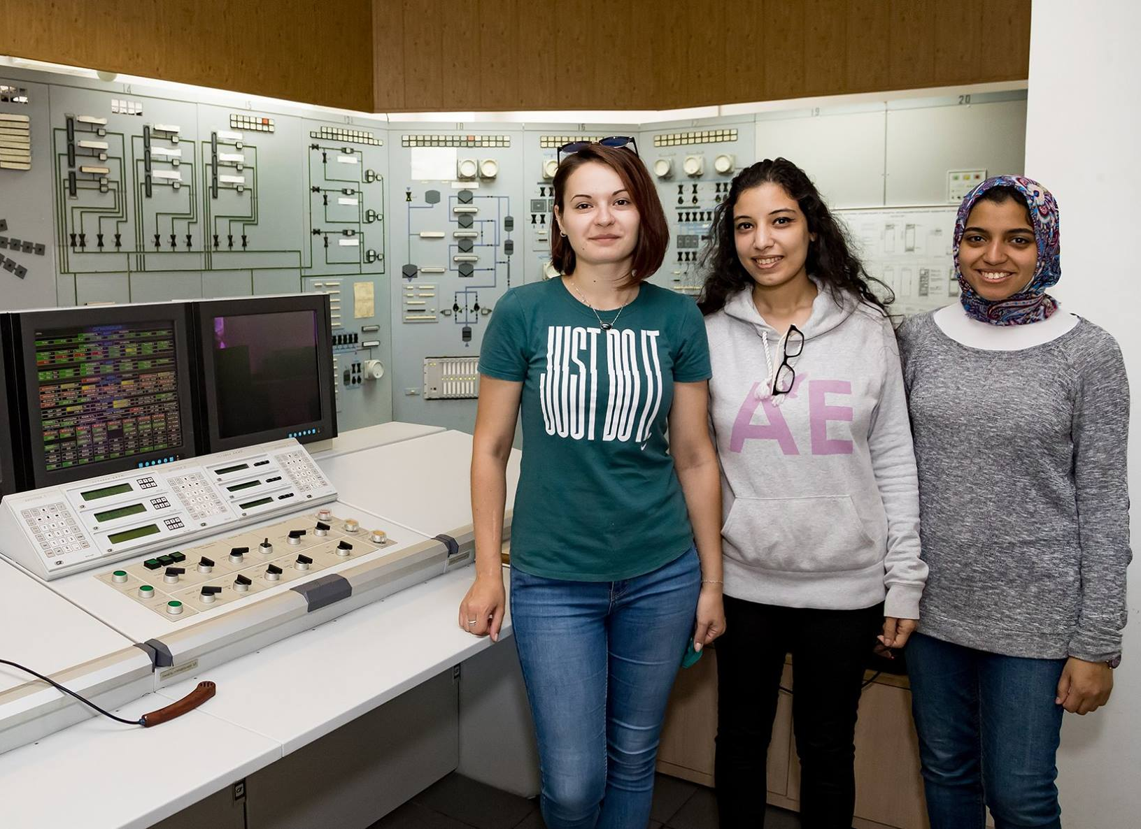
Summer Student Programme
Launched in 2014
competitive selection
longer term (6-8 weeks)
advanced level of projects
4th year BSc students,
MSc students,
1st year PhD students
students.jinr.ru
Application deadline for the JINR SSP-2021: 30 March

Slide 7
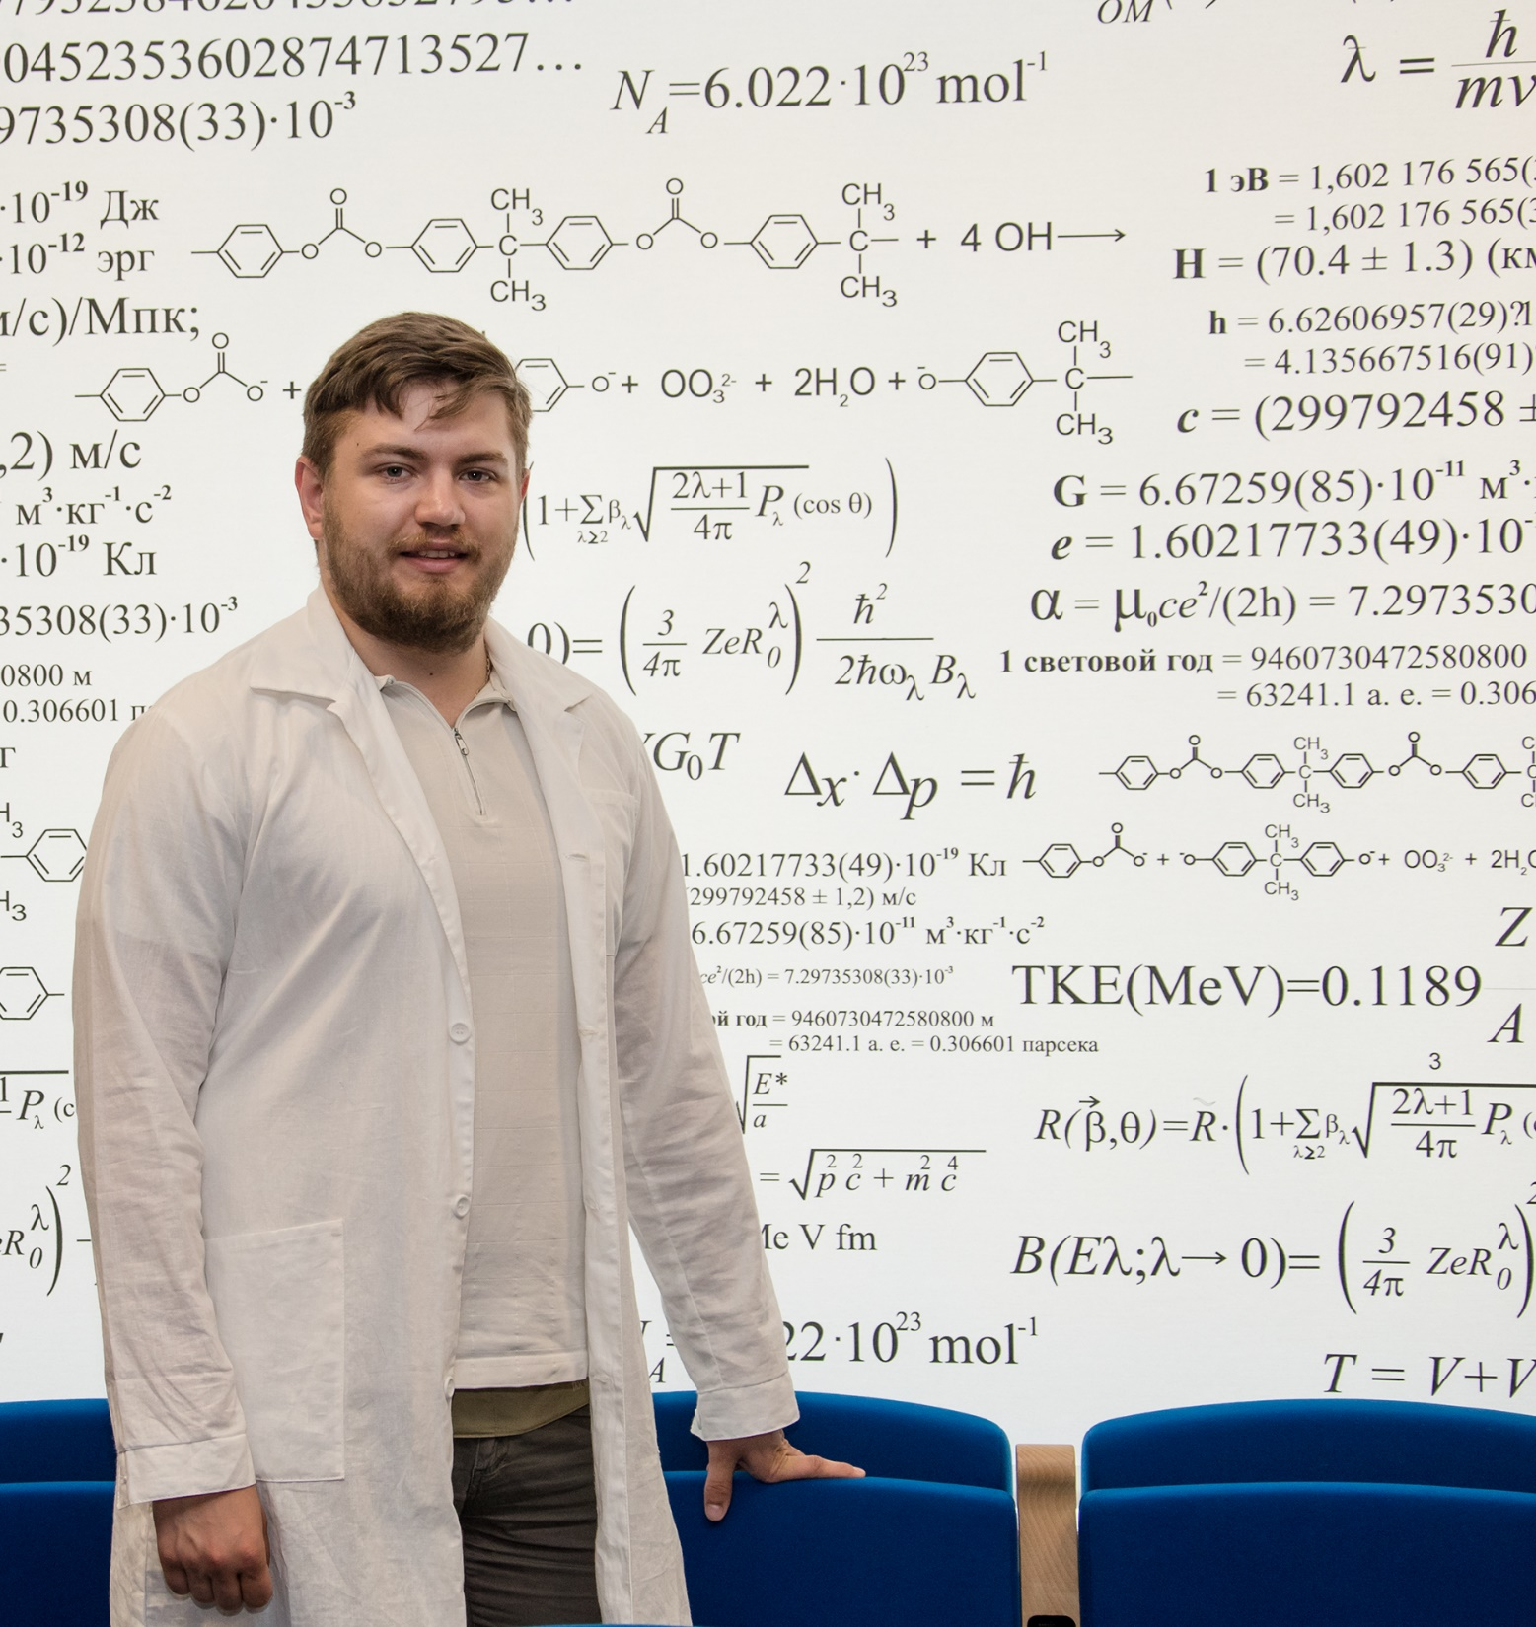
INTEREST
INTErnational REmote
Student Training at JINR
ONLINE programme
runs in Waves
duration 4-6 weeks
competitive selection
database of projects
for science / engineering / IT students starting from their 2nd year and postgraduates
interest.jinr.ru
Notes:
В сентябре 2020 г. УНЦ ОИЯИ запустил новую программу для студентов со всего мира. Она получила название INTEREST – сокращение от английского INTErnational REmote Student Training.
Программа позволит знакомиться с деятельностью Института и выполнять исследовательские проекты под руководством сотрудников ОИЯИ удаленно, не покидая собственного дома.
Программа рассчитана на студентов-физиков, будущих инженеров и специалистов IT.
Проходить она будет круглогодично, этапами, которые называются волны. Продолжительность каждой волны – 4-6 недель.
Информационной площадкой Программы является сайт interest.jinr.ru.

Slide 8
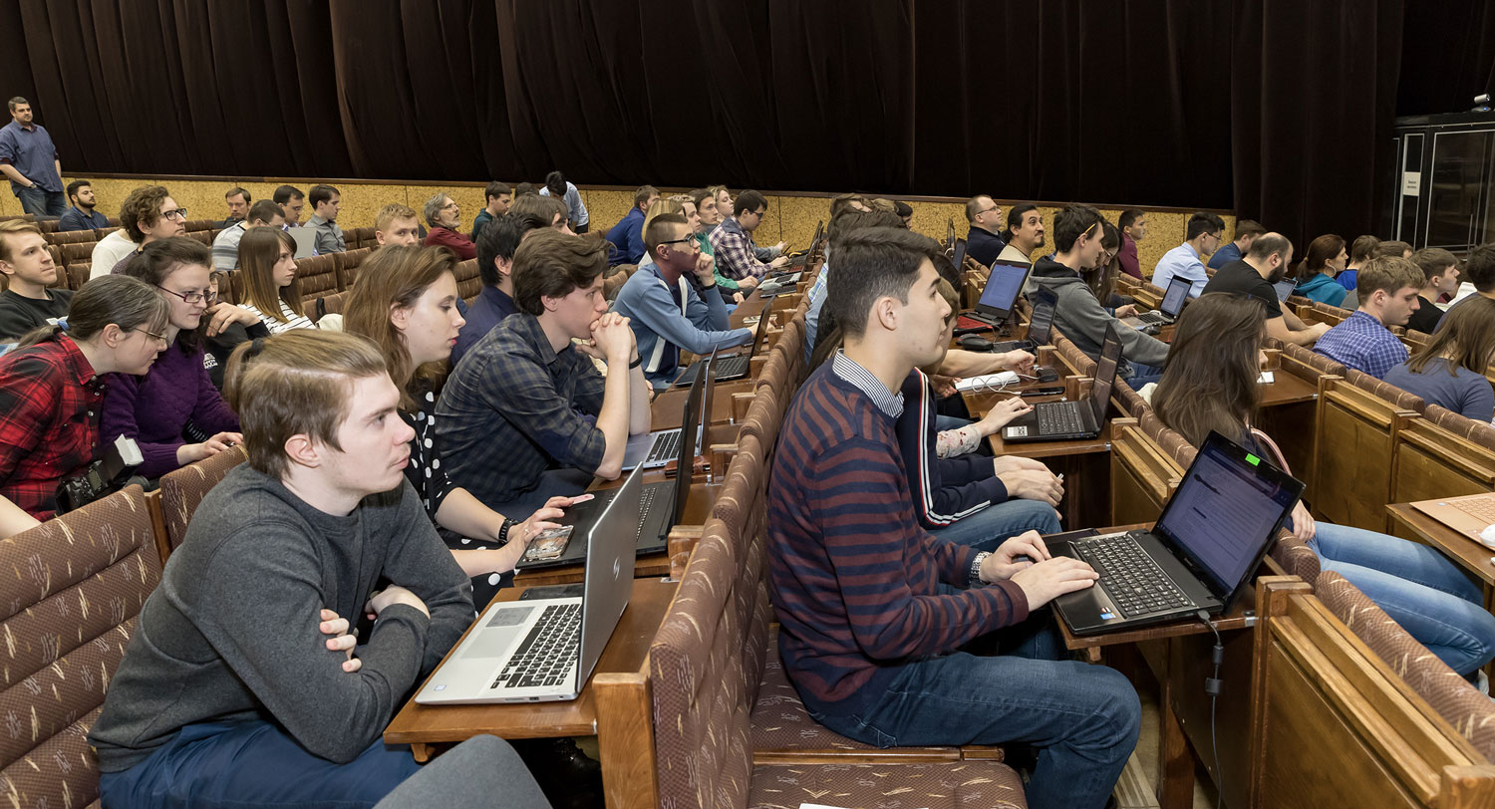
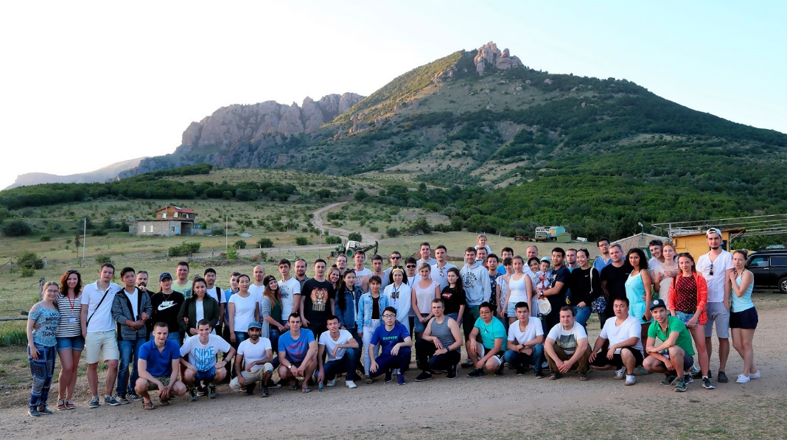
Annual conferences for young scientists & specialists
Organised by the JINR Association of Young Scientists and Specialists (AYSS)
In Dubna
& Alushta

Slide 9
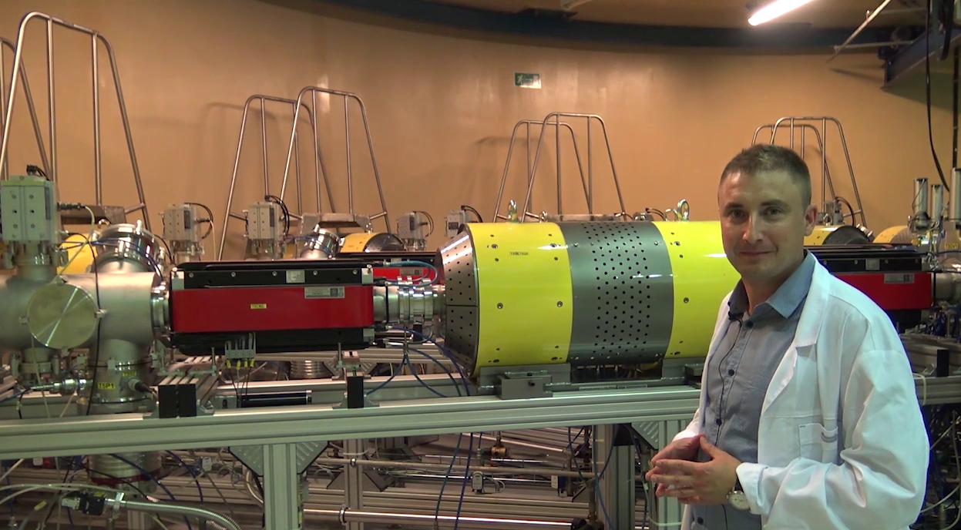
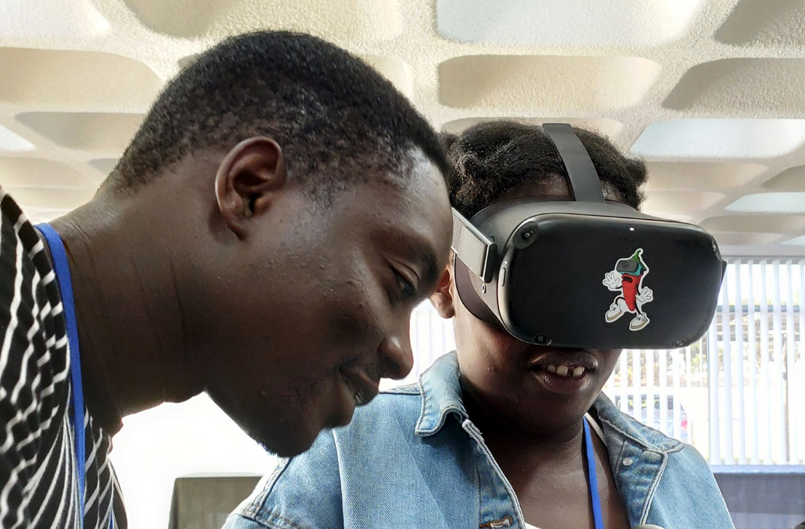
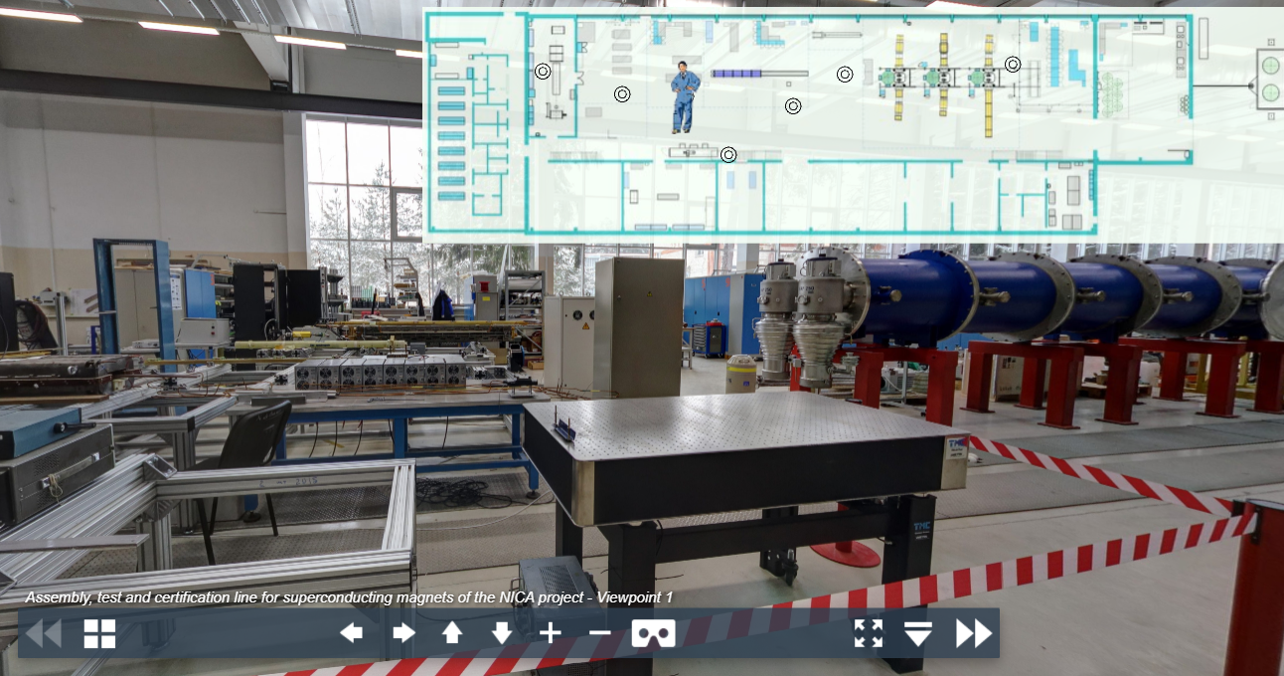
Online and virtual 3D tours to JINR facilities
uc.jinr.ru/en/3d
Live communication with scientists
Broadcasting from the JINR Labs

Slide 10
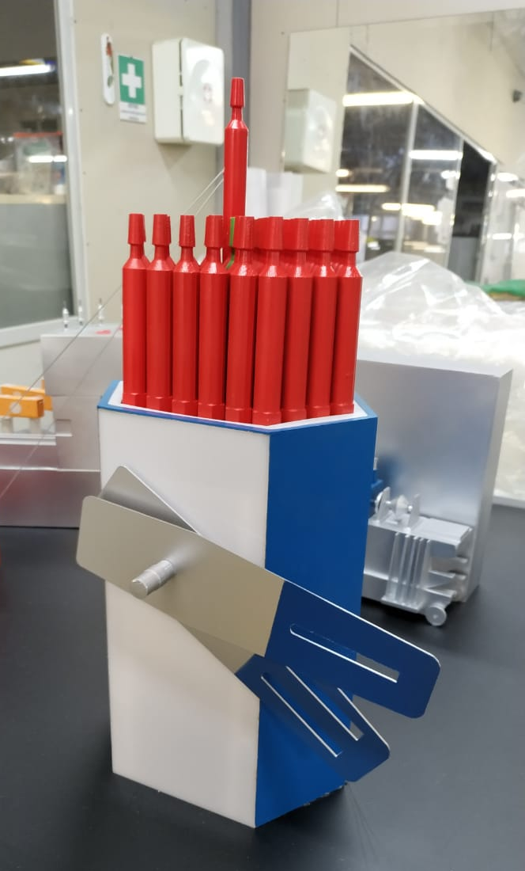
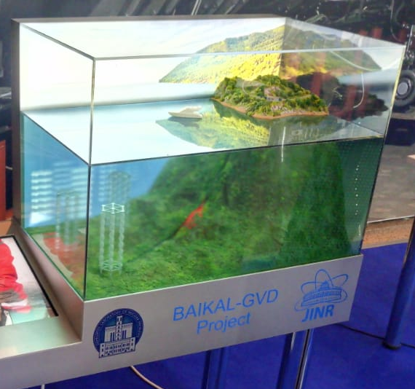
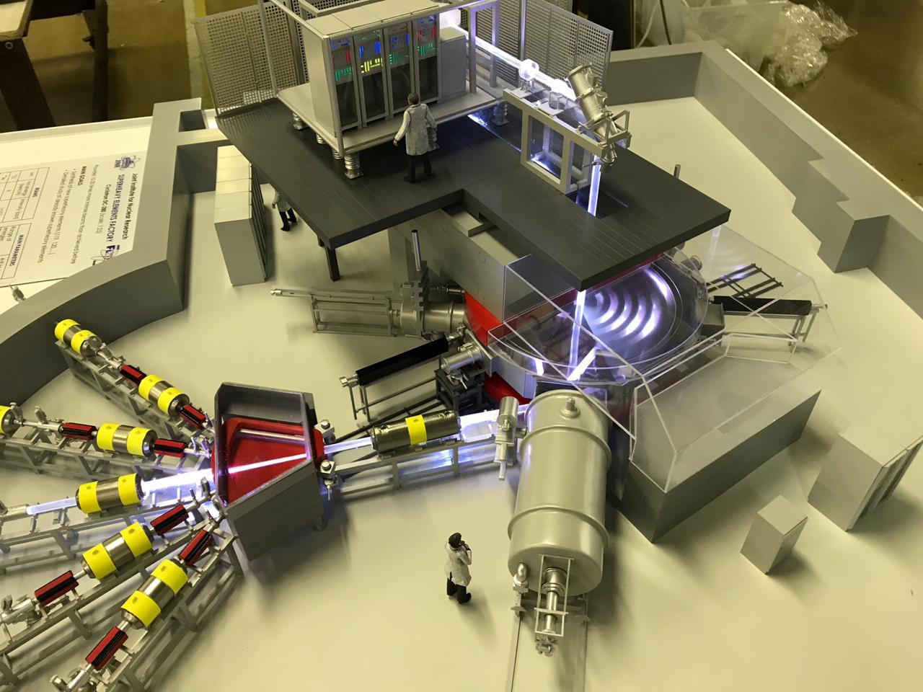
JINR basic facilities in miniature
IBR-2 pulsed reactor
Baikal neutrino telescope
DC-280 Accelerator, SHE factory
Medical and technical complex
Construction
Operation principles

Slide 11

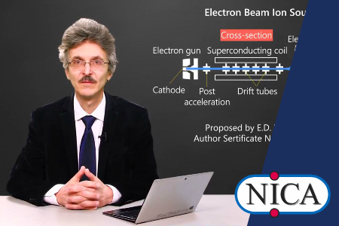
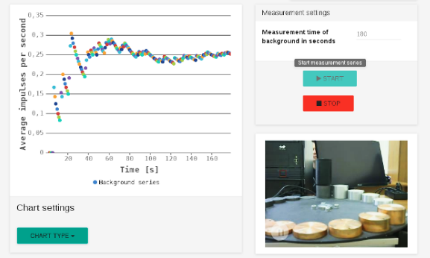
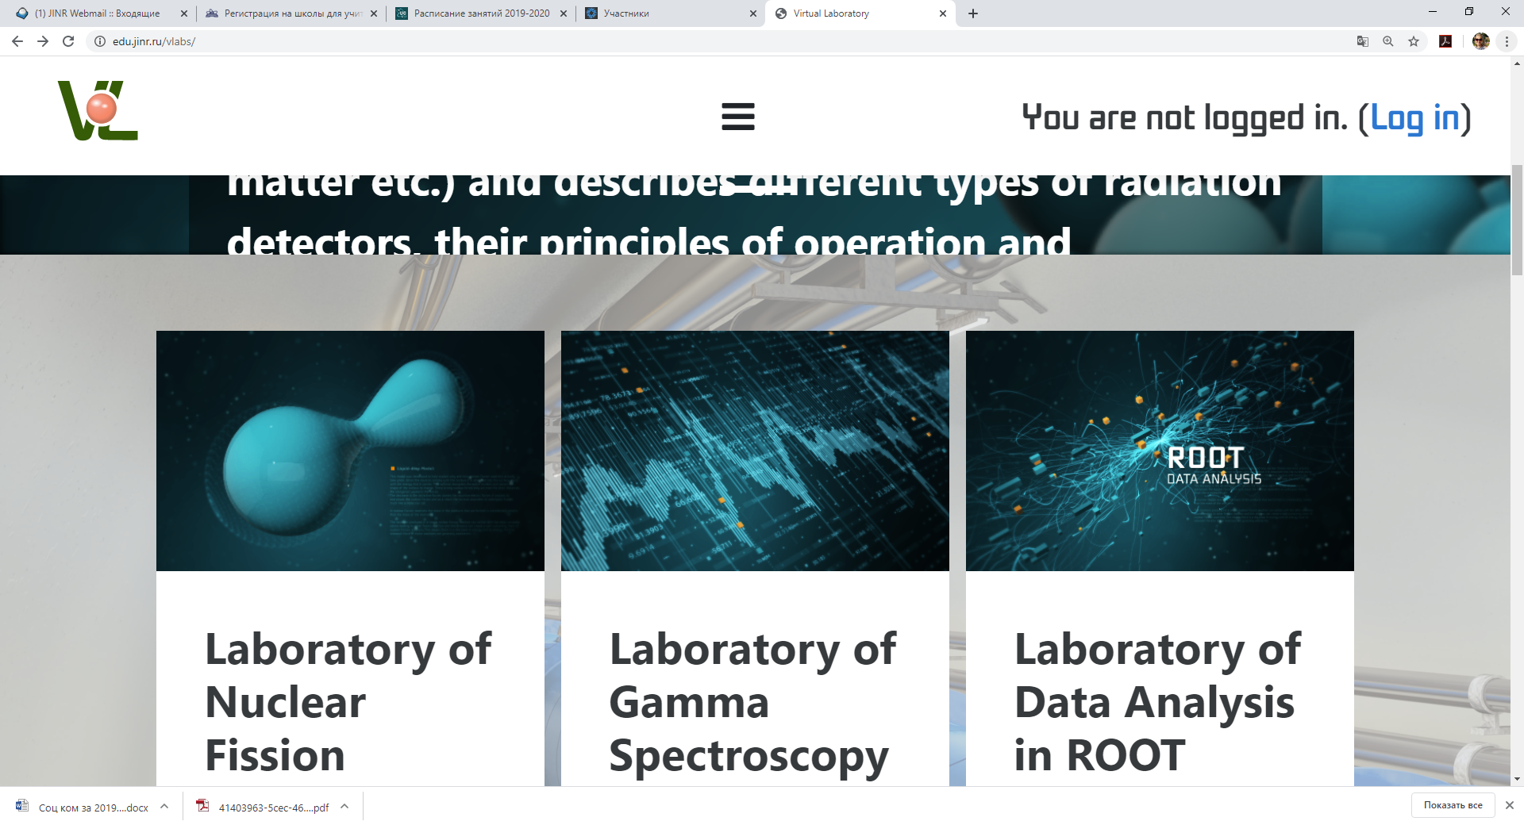
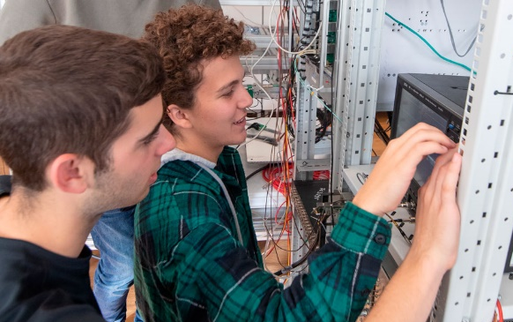
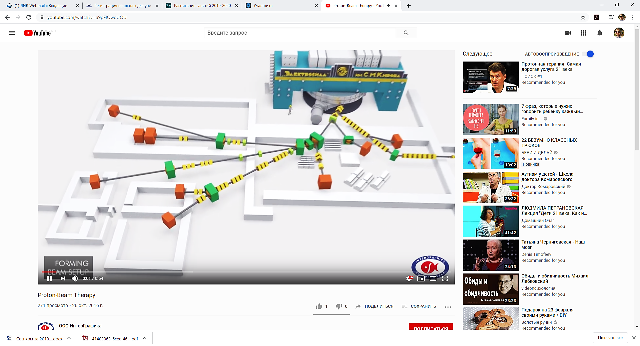
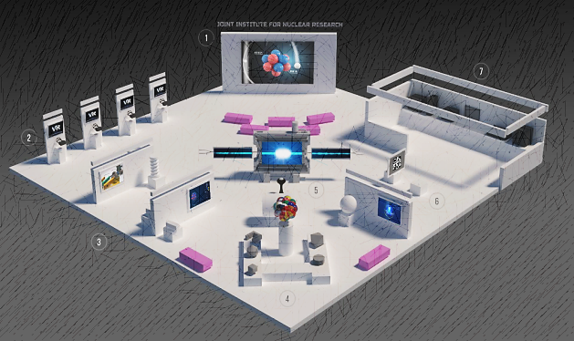
Open information and educational environment
for supporting fundamental and applied multidisciplinary research at JINR
edu.jinr.ru
Online courses for the
JINR Educational Portal
Remote lab works
on nuclear physics
Virtual Laboratory
for nuclear physics
Hands-on lab work
Multimedia
educational resources
JINR exhibitions
Notes:
The UC Educational Programs Development Department develops Open Educational Environment, the components of which are:
Online courses for the JINR Educational Portal
Development of the project “Virtual Laboratory for the Study of Nuclear Physics”
Multimedia educational resources for physics teachers and high school students
Platform for remote practicums in nuclear physics
Hands-on practicum using real research equipment
JINR Expositions
_____________________________________________
Отдел разработки образовательных программ УНЦ создает Открытую образовательную среду, компонентами которой являются:
Лекционные видеокурсы для образовательного портала ОИЯИ
Развитие проекта «Виртуальная лаборатория ядерной физики»
Создание мультимедийных образовательных ресурсов
Платформа для проведения удаленных практикумов по ядерной физике
Лабораторные работы на реальном оборудовании
Выставки ОИЯИ

Slide 12
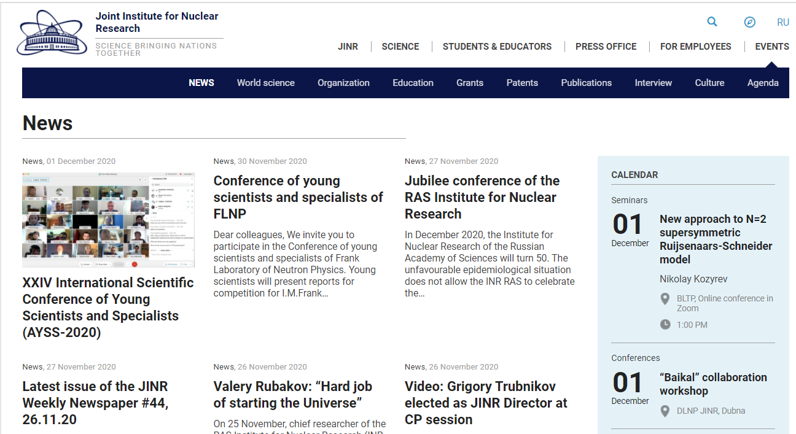
News on the JINR website
www.jinr.ru/posts/category/news-en//

Slide 13
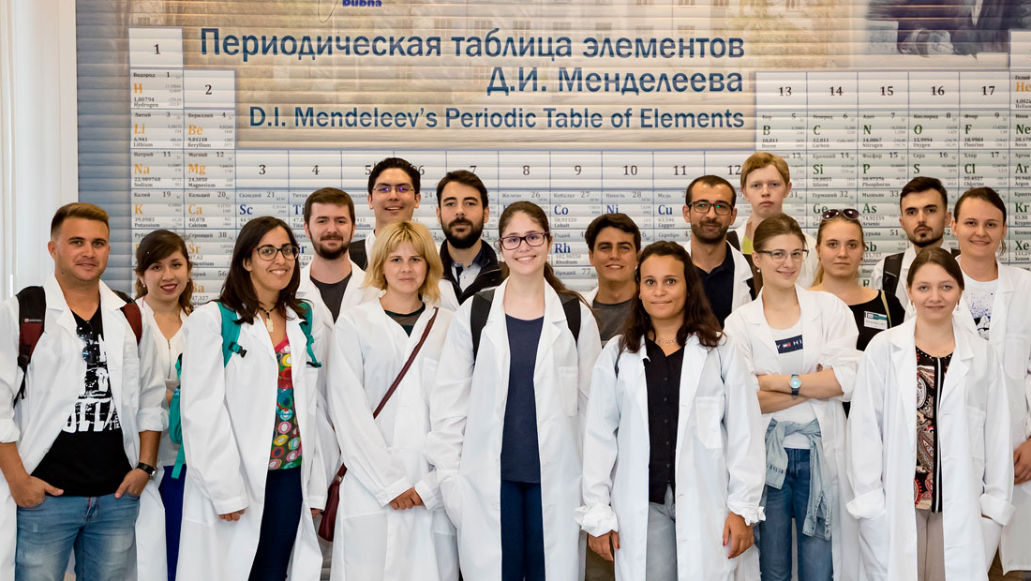
Science brings nations together
Welcome to our international scientific community!

